Slide 2
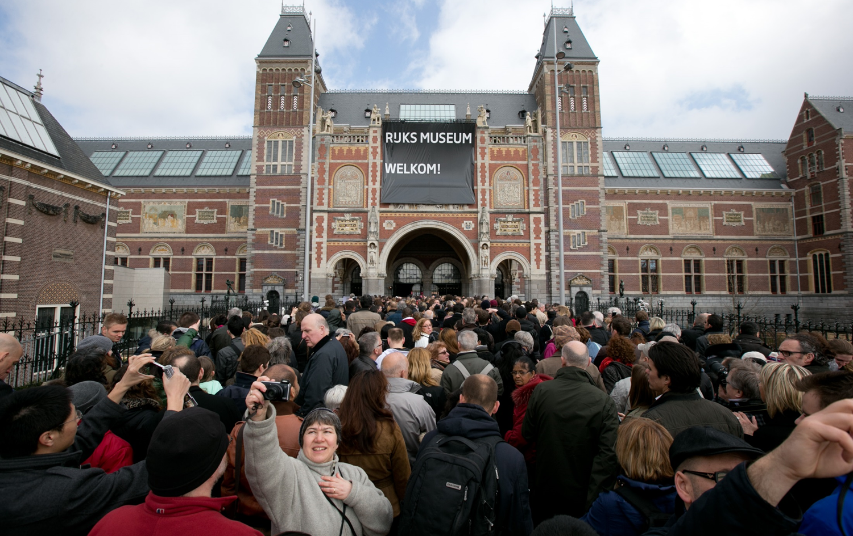
The Art of Enterprise Architecture
Rijksmuseum
21 mei 2025

Slide 3
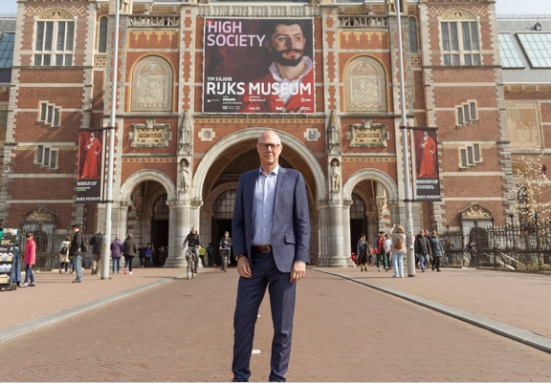
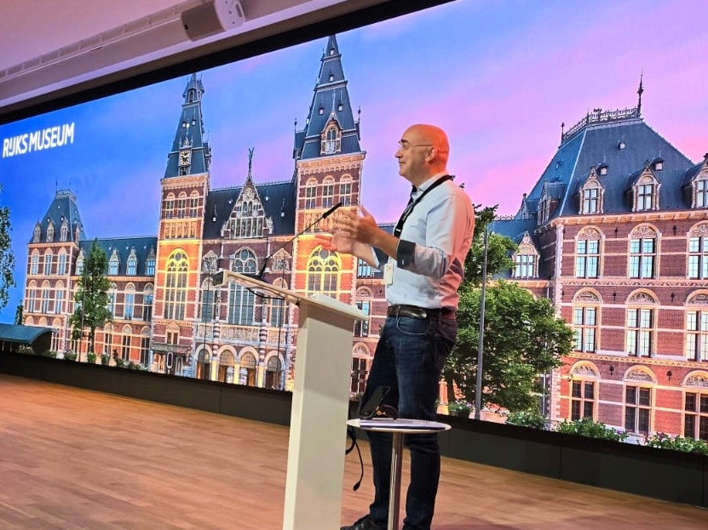
Introduction
Rob Hendriks – former CIO, Rijksmuseum
Robbert Steman – EA, Rijksmuseum

Slide 4
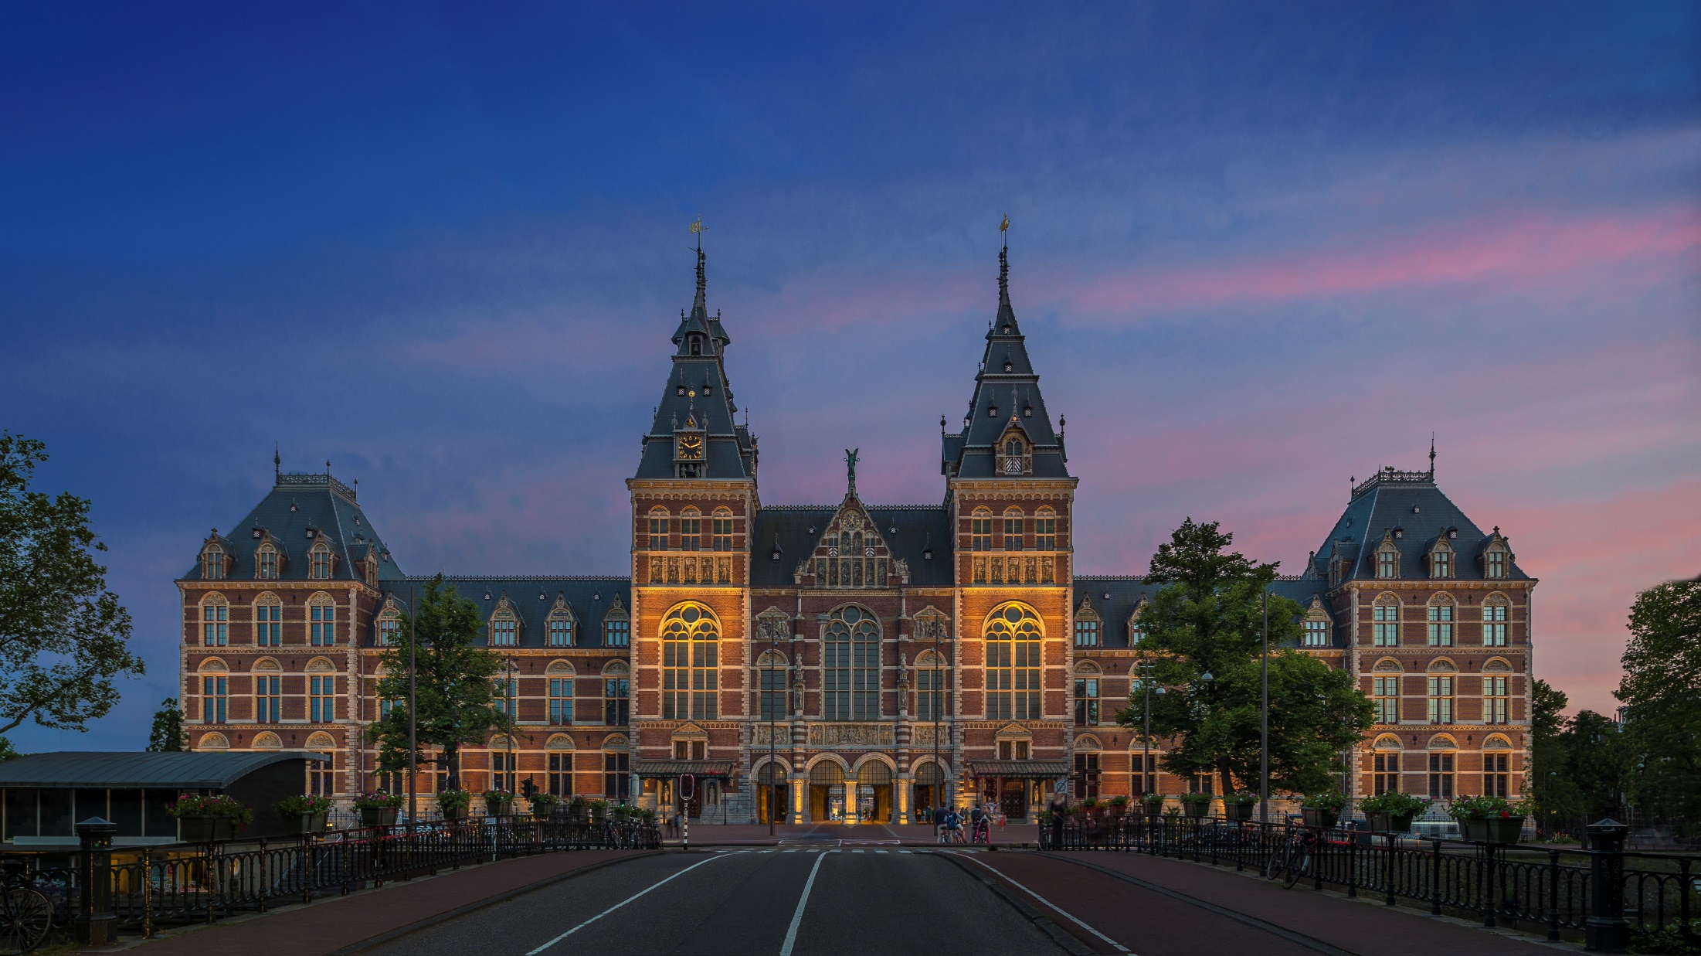
The Rijksmuseum connects people, art, and history.
Founded in 1800
Notes:
top ten museums in the world
renowed collection of 17 centure Dutch masters
largests collection of Rembrandts
Vermeer, etc

Slide 5
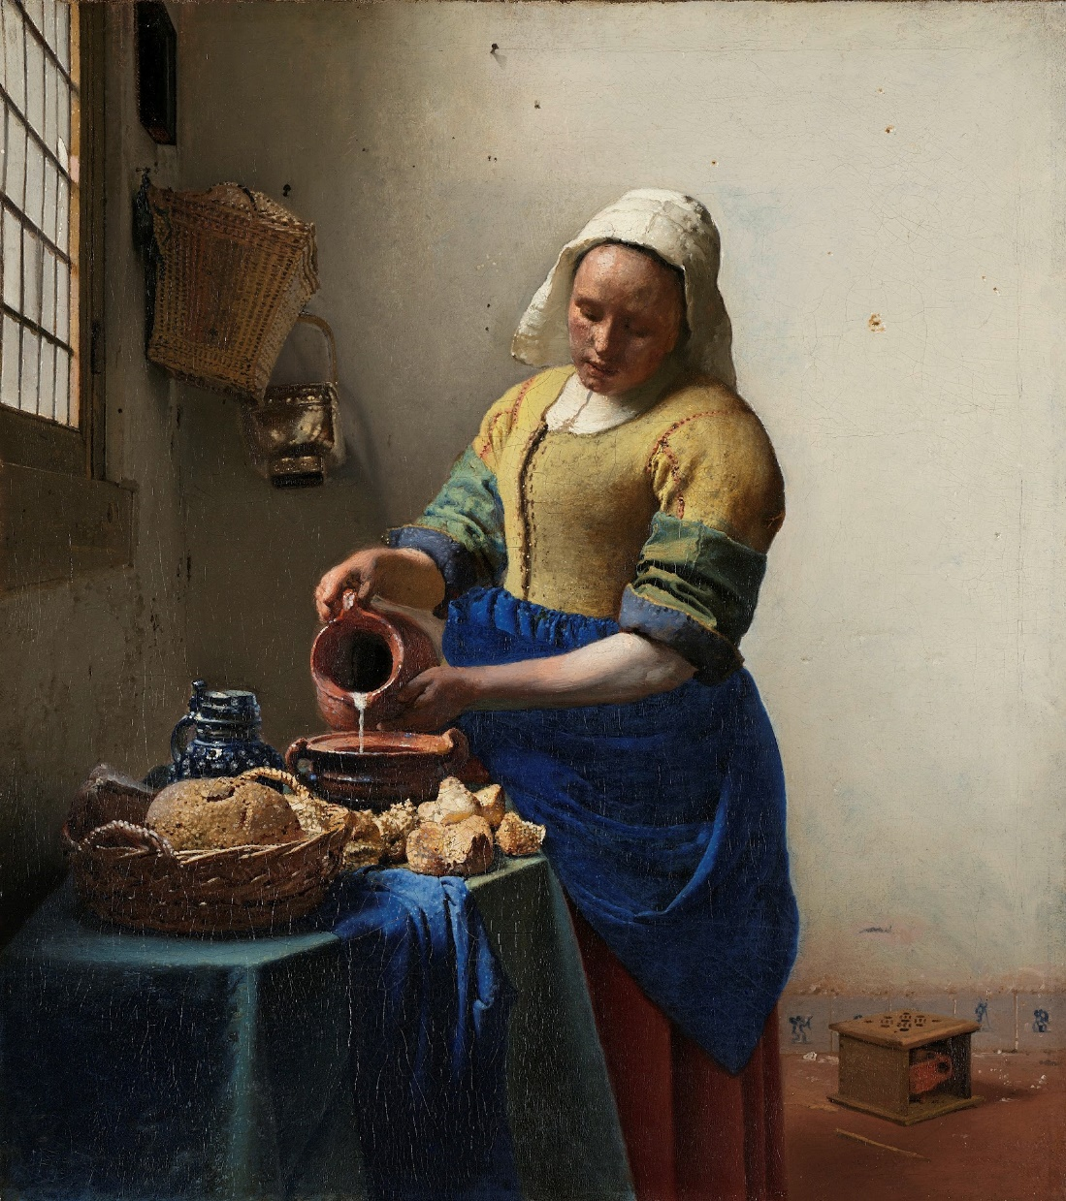

collection: 1.1 million objects
approximately 1000 employees
Amsterdam, Amersfoort
2.7 million visitors per year
8.1 million unique visitors online
Social channel reach: 70 million

Slide 6
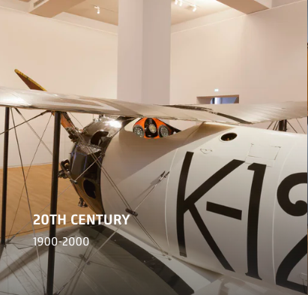
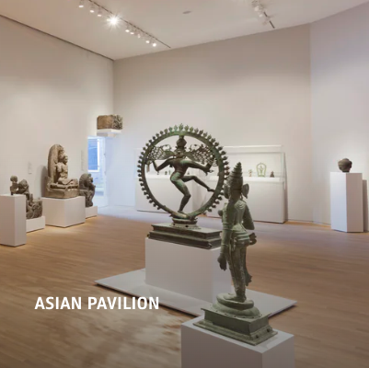
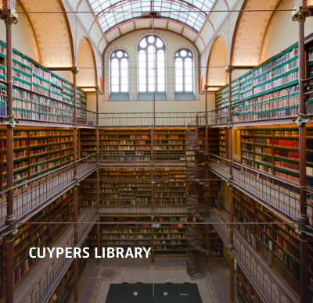
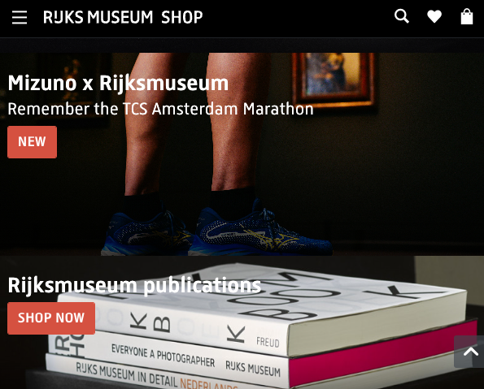
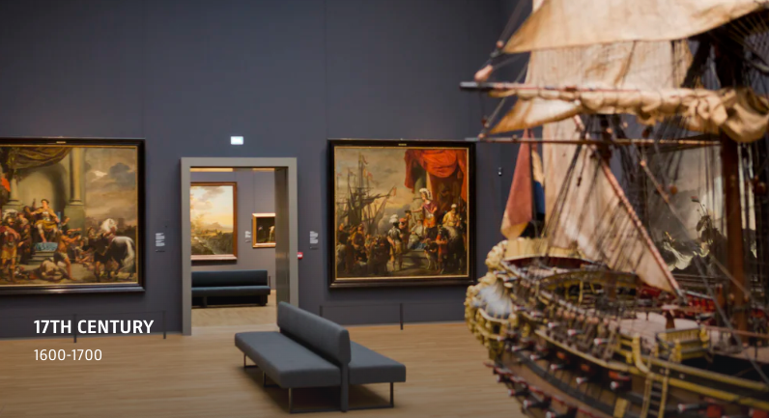
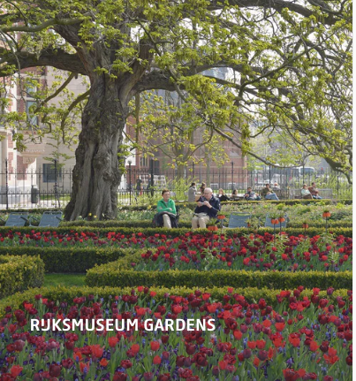
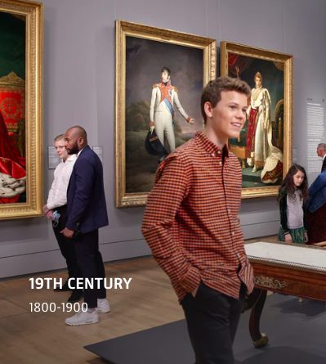
800 years of Dutch history, from 1200 to the present

Slide 7
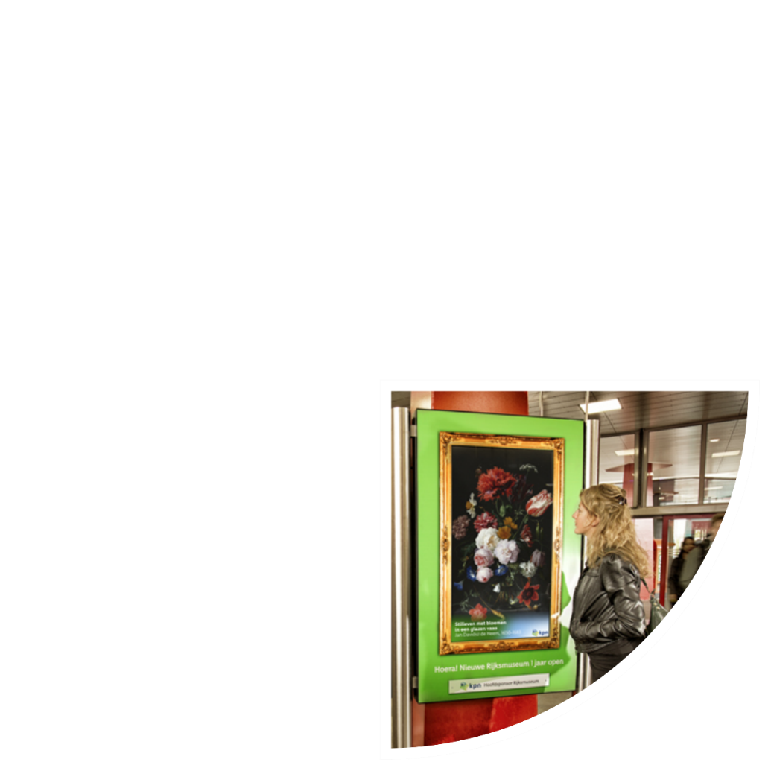
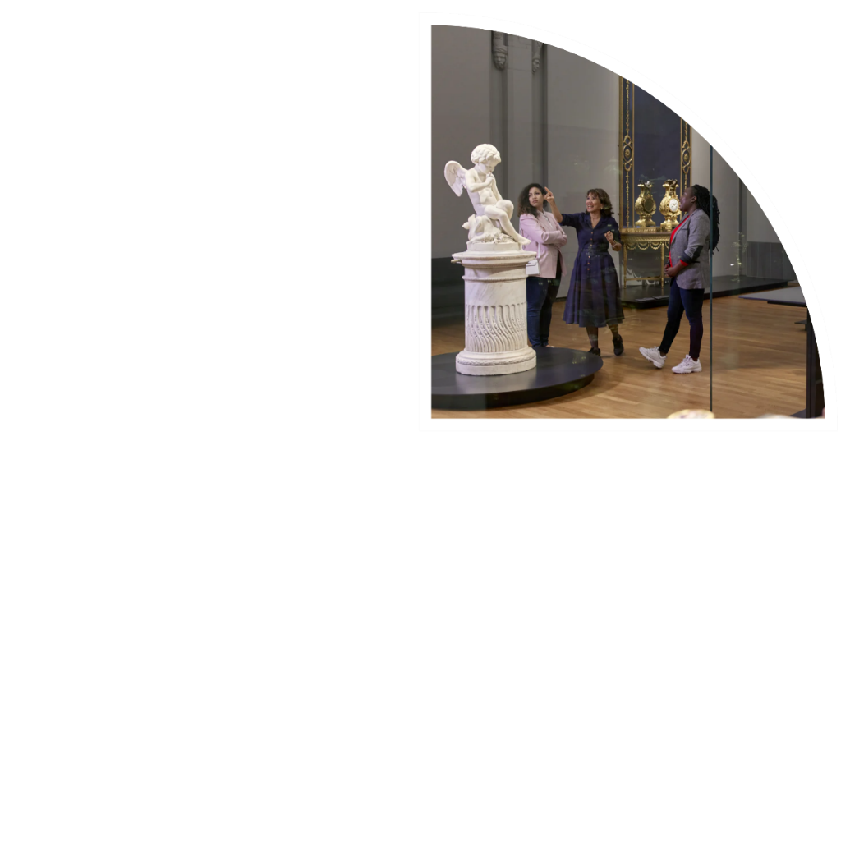
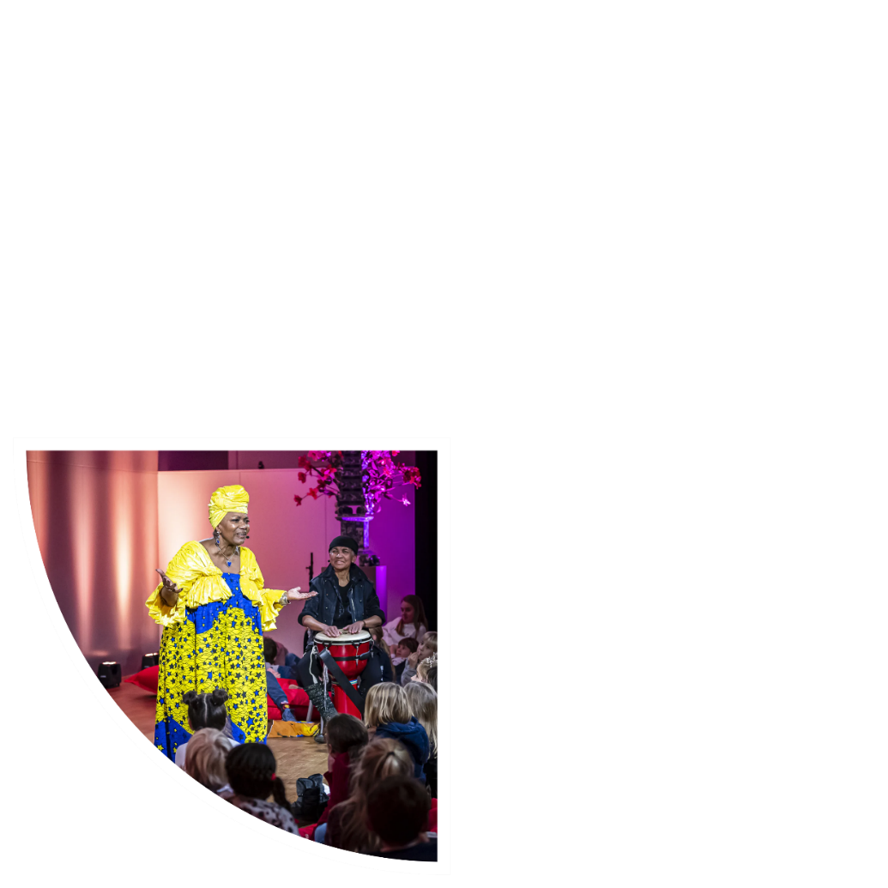
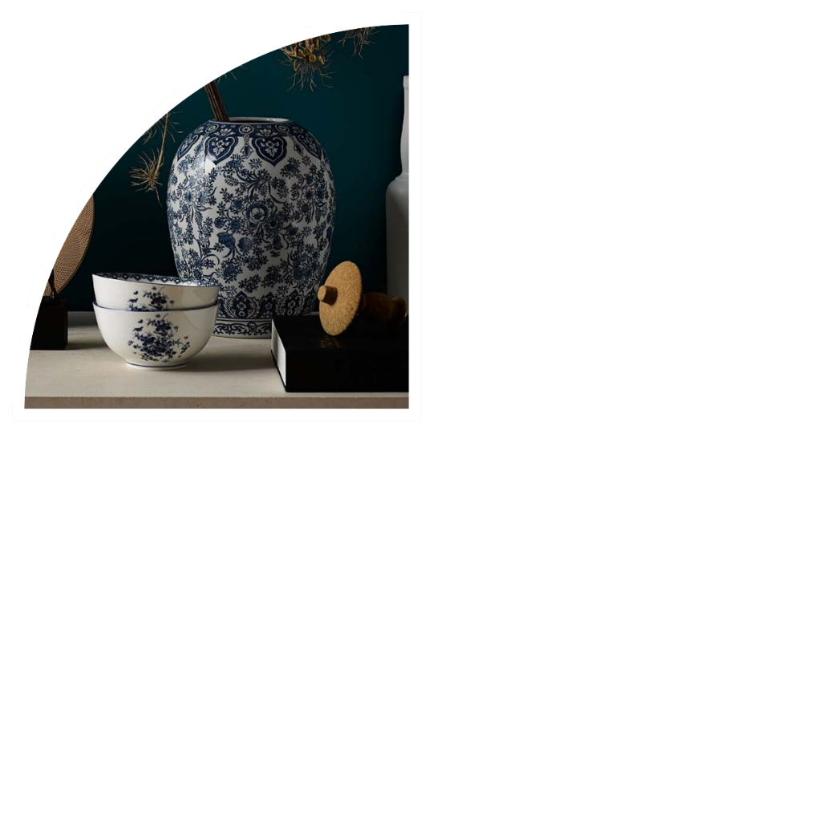
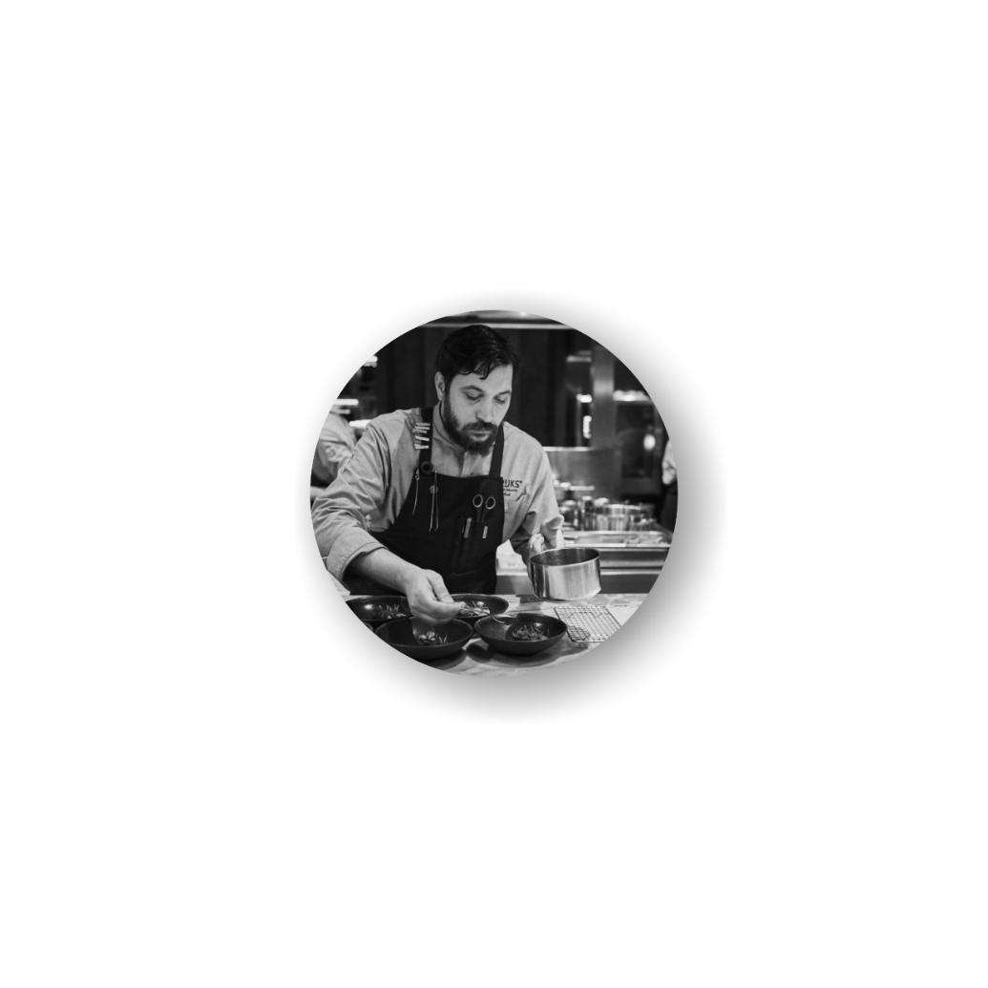
120 million euro revenue​
Retail & Merchandising
visitors
RIJKS restaurant
Michelin*
Venue / Events
Partners
Activities

Slide 8
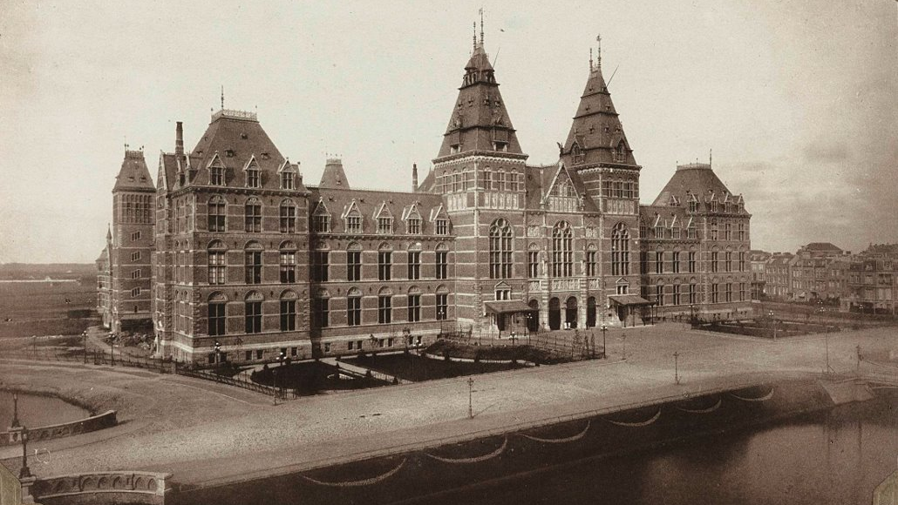
1885
Enterprise Architecture in a museum?
Notes:
storyline: Why EA in a museum?
The challenge for us is that we do not have one business model, it is not about just selling as many tickets as we can. That is important, but we are also a venue for events (over 500 events, online … , educational … and a research institute.
For the organization, and especially IT, it is not that easy to prioritize and decide where to focus on.
In our strategy, we use the credo COLLECTION -> CONNECTION -> CONVERSION to describe how we see the journey of our customers. Our unique art collection is what differentiates us from the rest of the (leisure) market. That is the basis of everything we do, whether it is welcoming visitors or selling products in the shop, setting up an educational project, or doing research. The next step is to build a connection with our visitors (online and offline). Storytelling, education, and marketing are used to build this connection. Finally, conversion: we want our customers to come again, sell them interesting programs and friendships, and based on what we know (CDP) give them the best experience.
This gives IT and the business a better understanding of where to focus on, to identify value chains and to develop the right capabilities

Slide 9
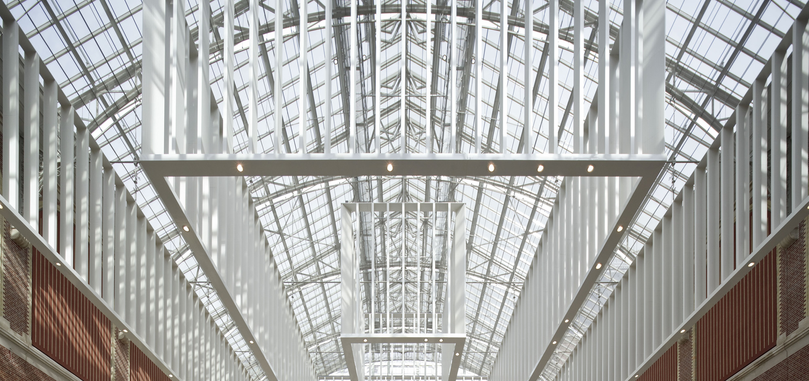
COLLECTION
CONNECTION
CONVERSION
Collection Management
Digital Asset Management
(DAM)
Research
Website, Online Educational Programs
Storytelling
Marketing
Friendships/loyalty
Hostmanship
Inclusive
Retail
Customer Data Platform
Resellers
Paid digital content
New business
Strategy on one page

Slide 10
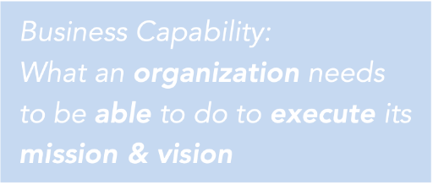
Rijksmuseum’s journey - bottom up
STEP 1
STEP 2
STEP 3
STEP 4
h
mgmnt
strategy
business
capabilities
business goals
business units
re-usable
business processes
business capabilities
project portfolio
application landscape
technology layer
* tooling!
IT
projects
What do we have?
How do we use it?
What is our goal?
Notes:
How did the Rijksmuseum implement EA and the concept of business capabilities? Our approach was more or less bottom-up.
To align IT better with the business I had to better know our IT landscape and understand better what the business was doing. (steps 1 and 2).Once business and IT had a shared view on how technology supports their processes, the time was there to create a shared vision: which capabilities do we need? How do we align this with the organization's strategy? Does the board support this?
Our journey:
step 1: (IT - What do we have?) to be able to manage the IT infrastructure better accommodate the expected changes
step 2: (IT/business - what do we do?) better understand where technology facilitates the business processes and visualize the enterprise workflows for the business units
step 3: (IT/Business/board - what is our goal?) connect projects better to the strategy, introduce business capabilities and value streams
step 4: How do we get there? How do we use our capabilities to help us prioritize projects?

Slide 11
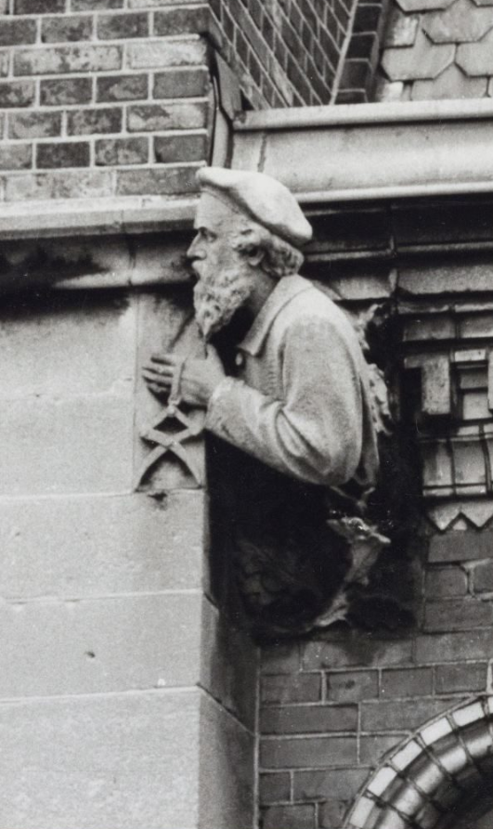
Why Business Capabilities?
Serves as a common language for business and IT
helps to form a common visualization of how digital transformation can be achieved
Business Capabilities

Slide 12
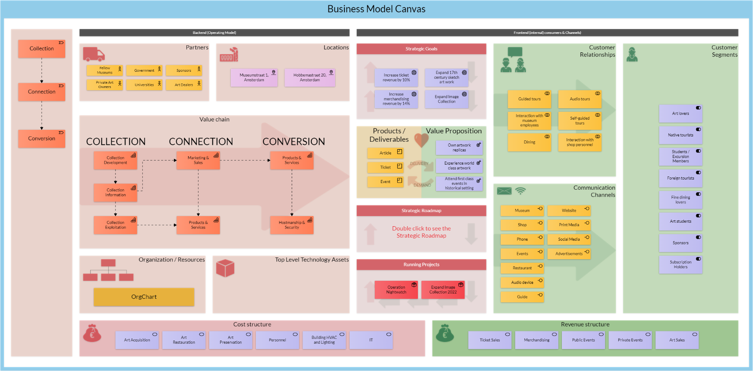
Collective image #1 Business Model Canvas

Slide 13
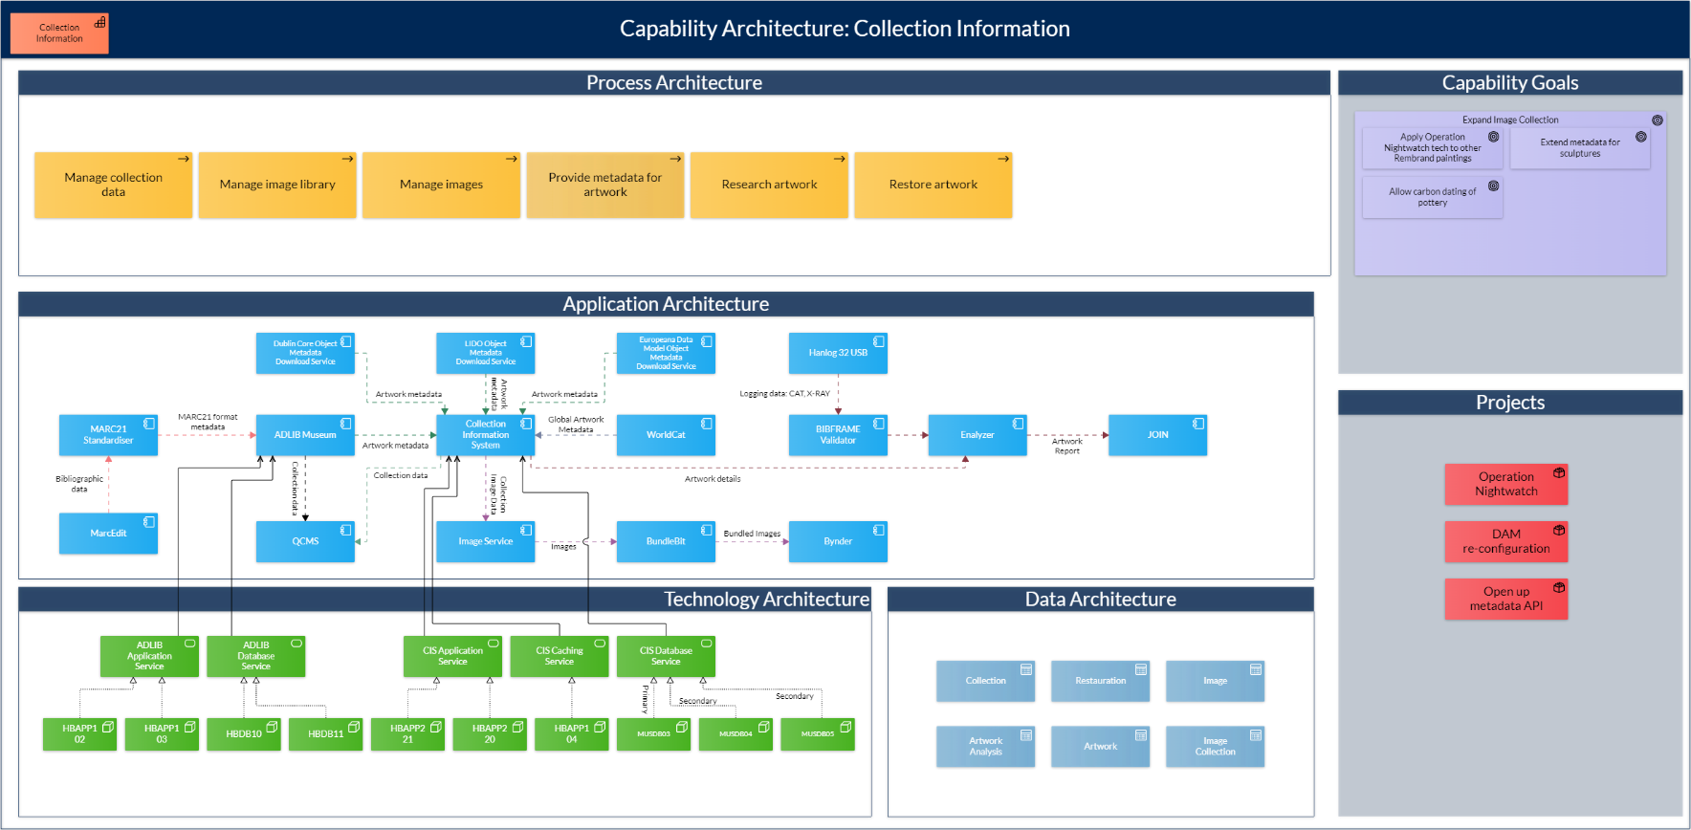
Collective image #2: Capabilities

Slide 14
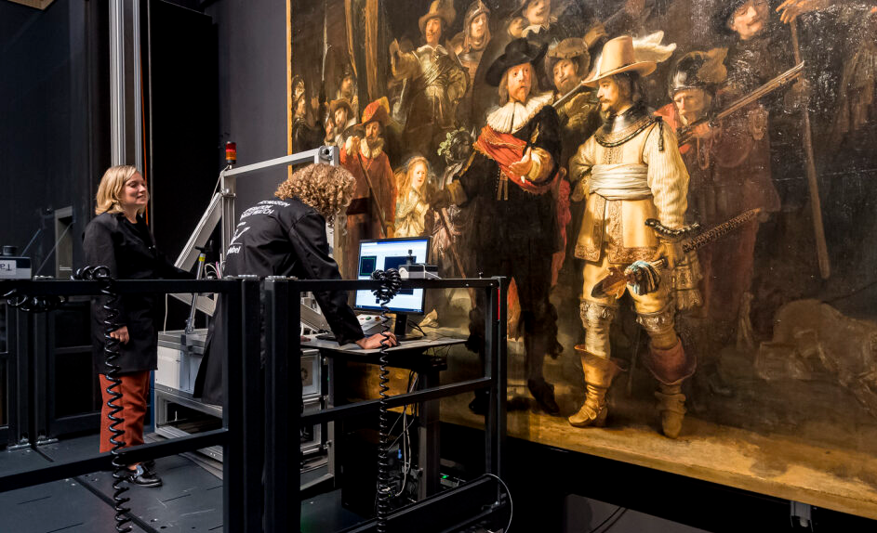
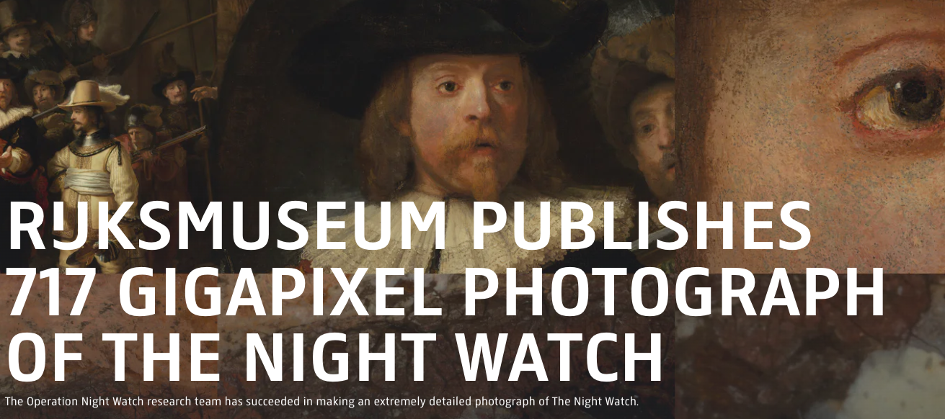
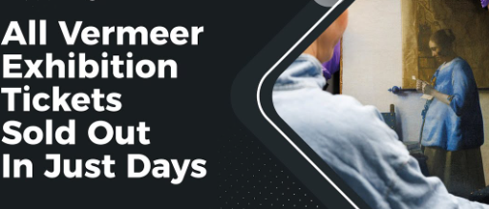
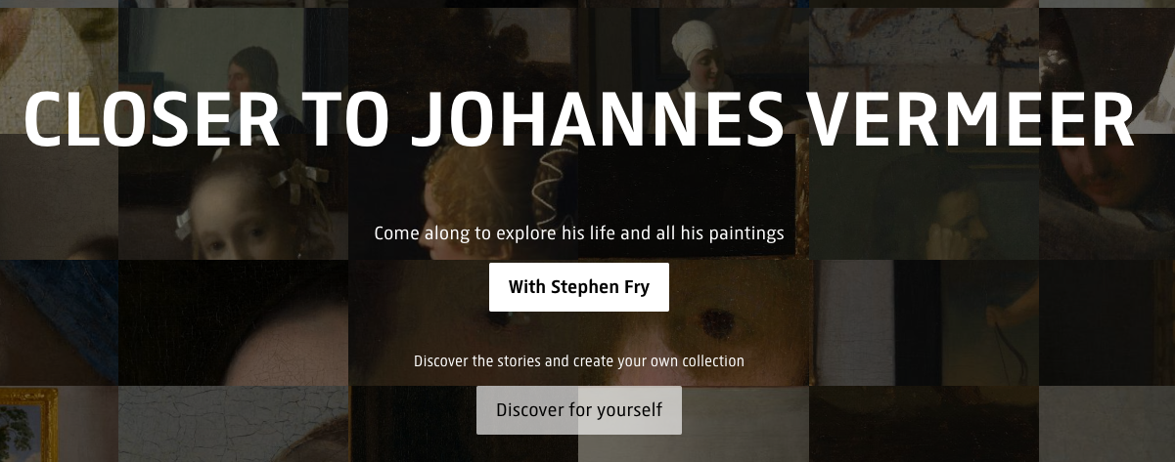
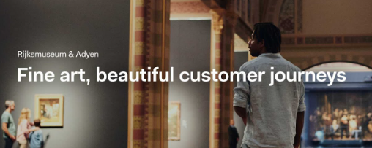
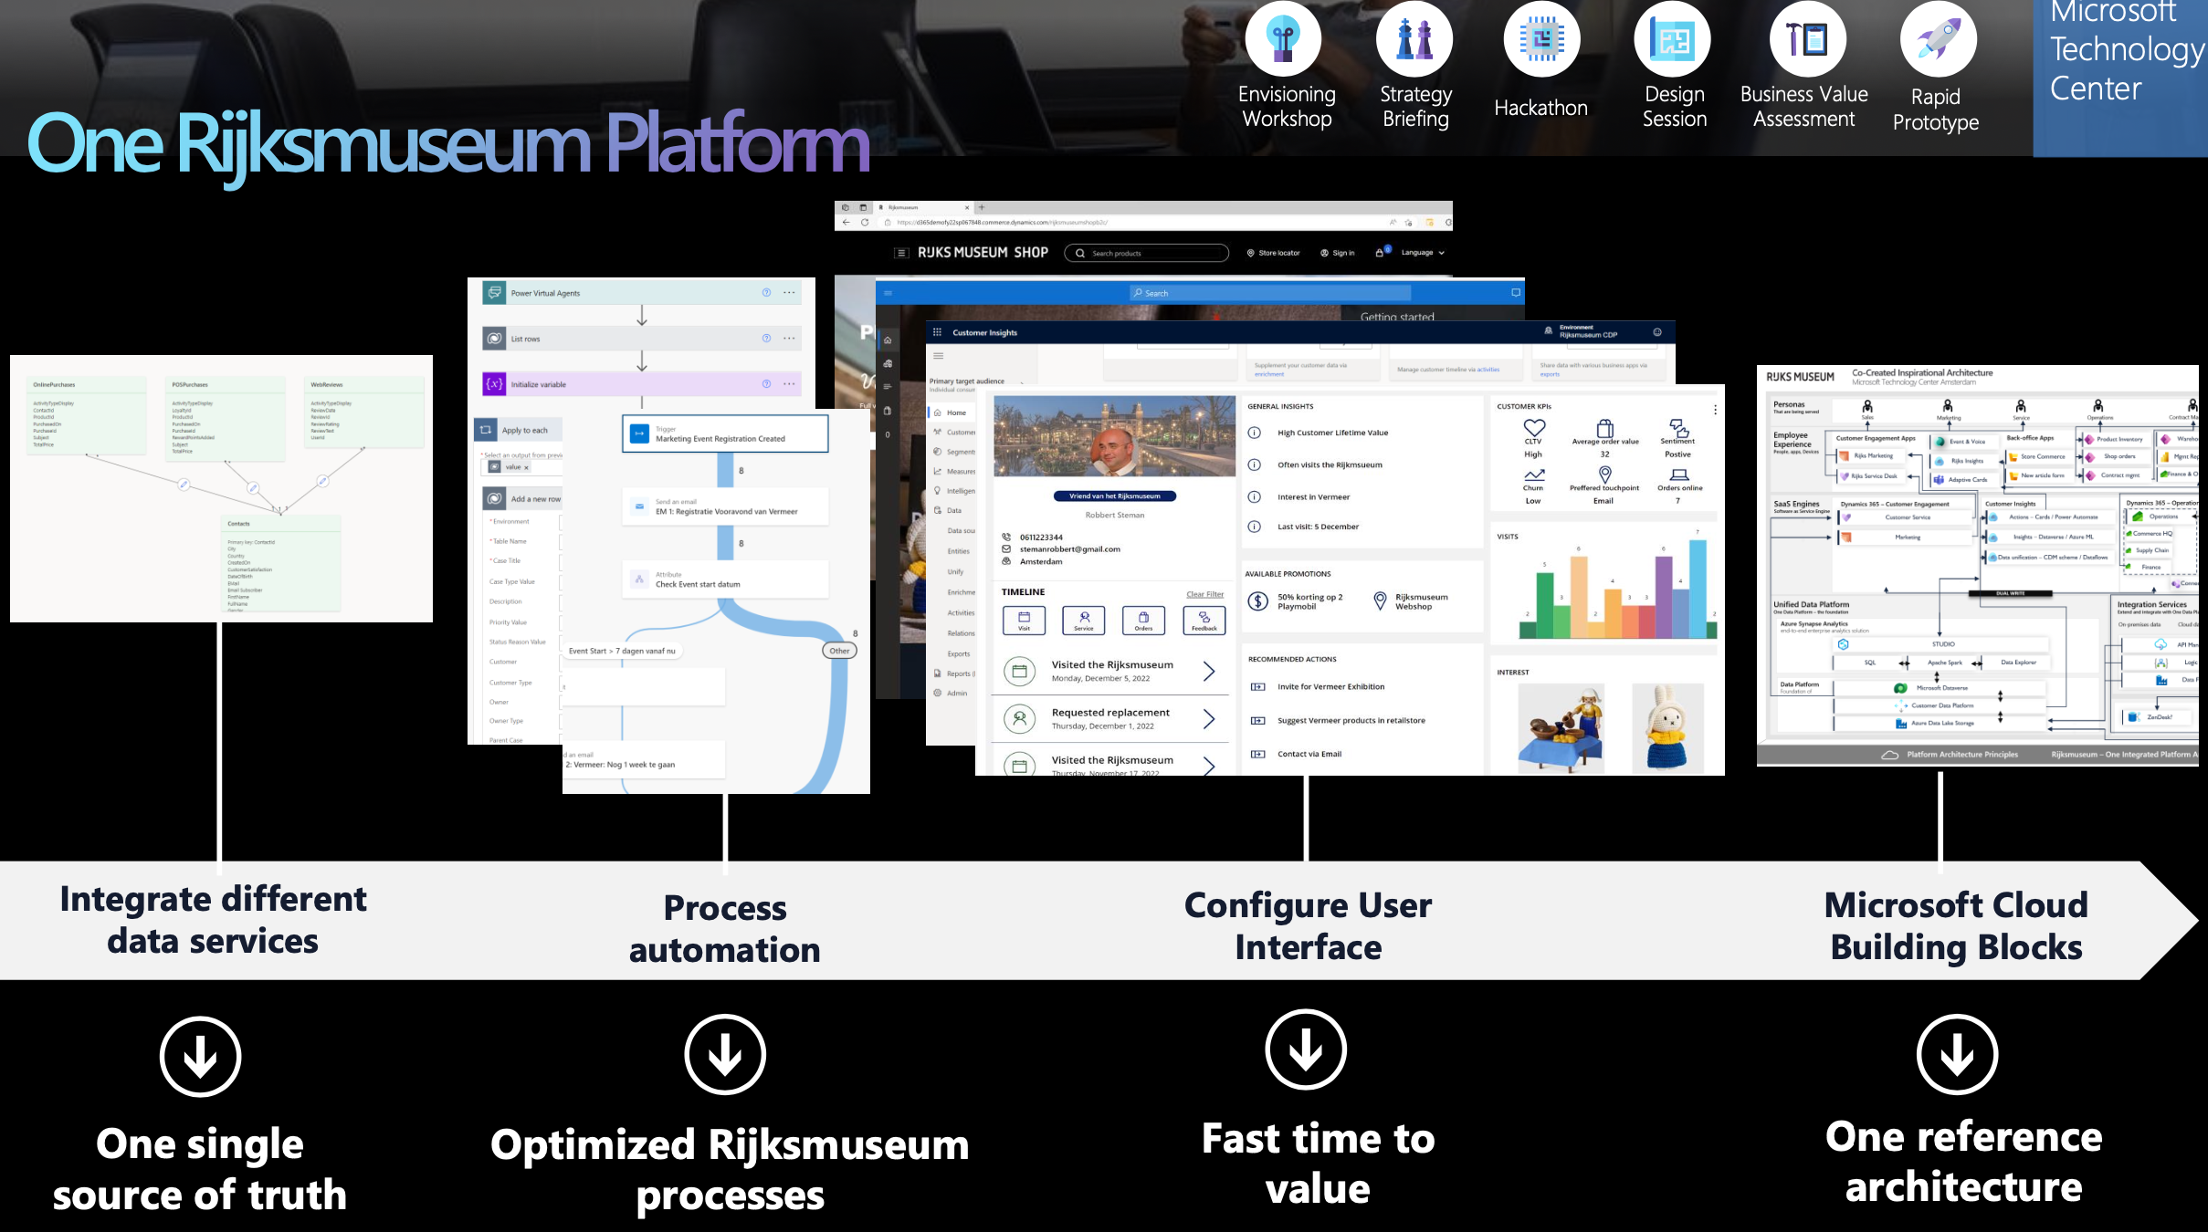
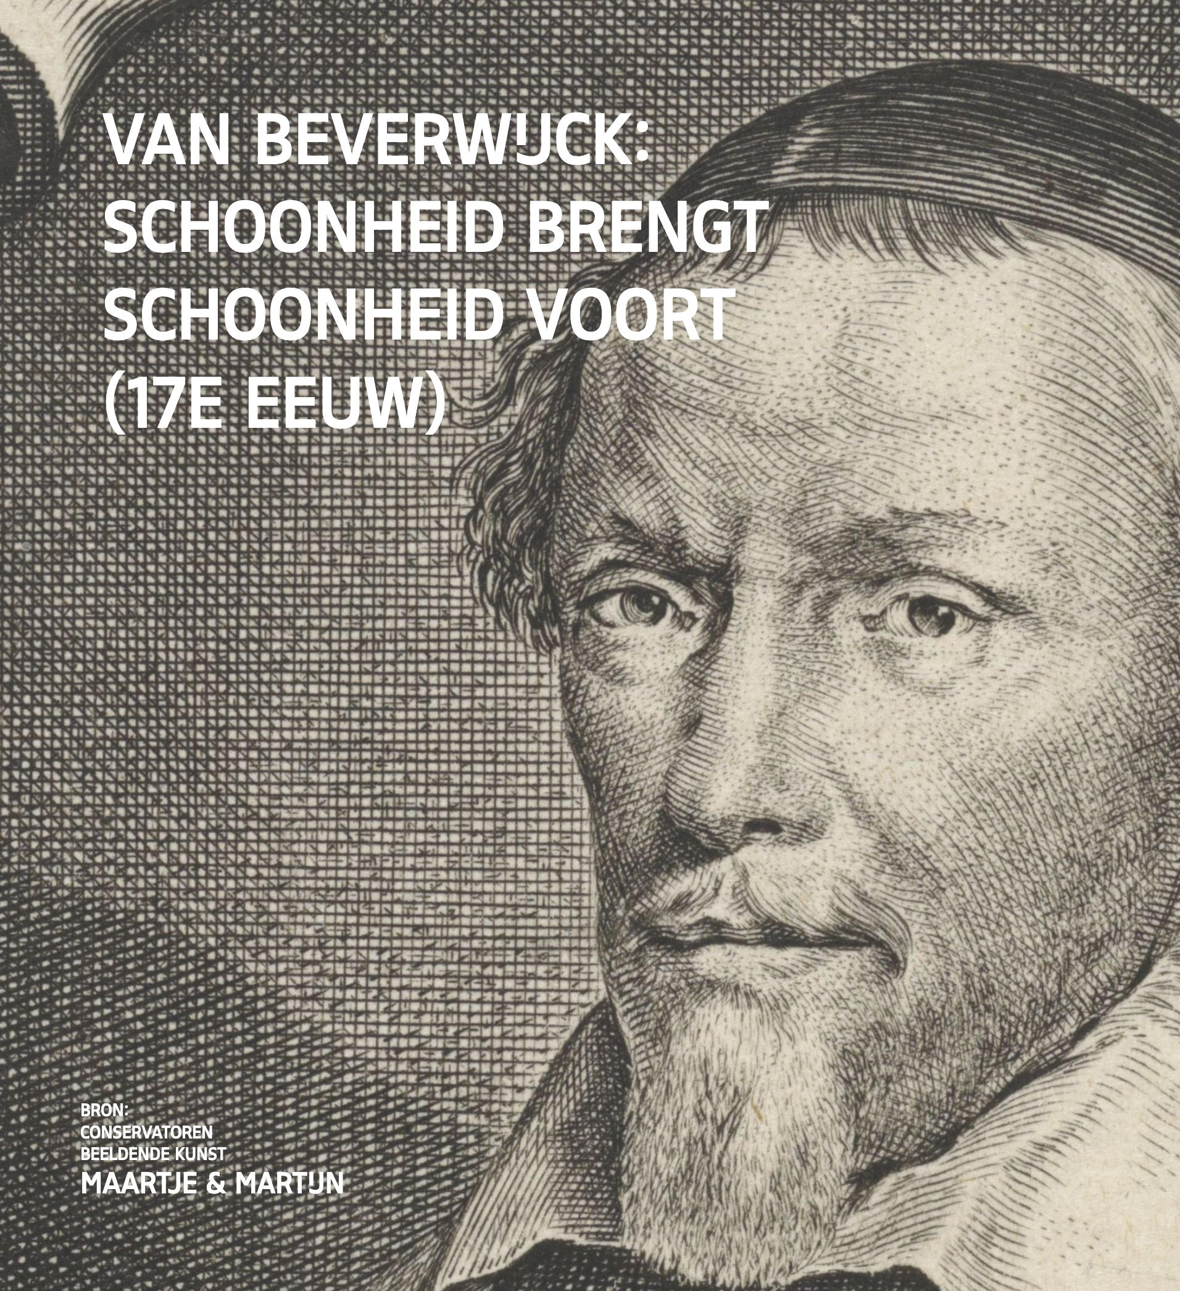
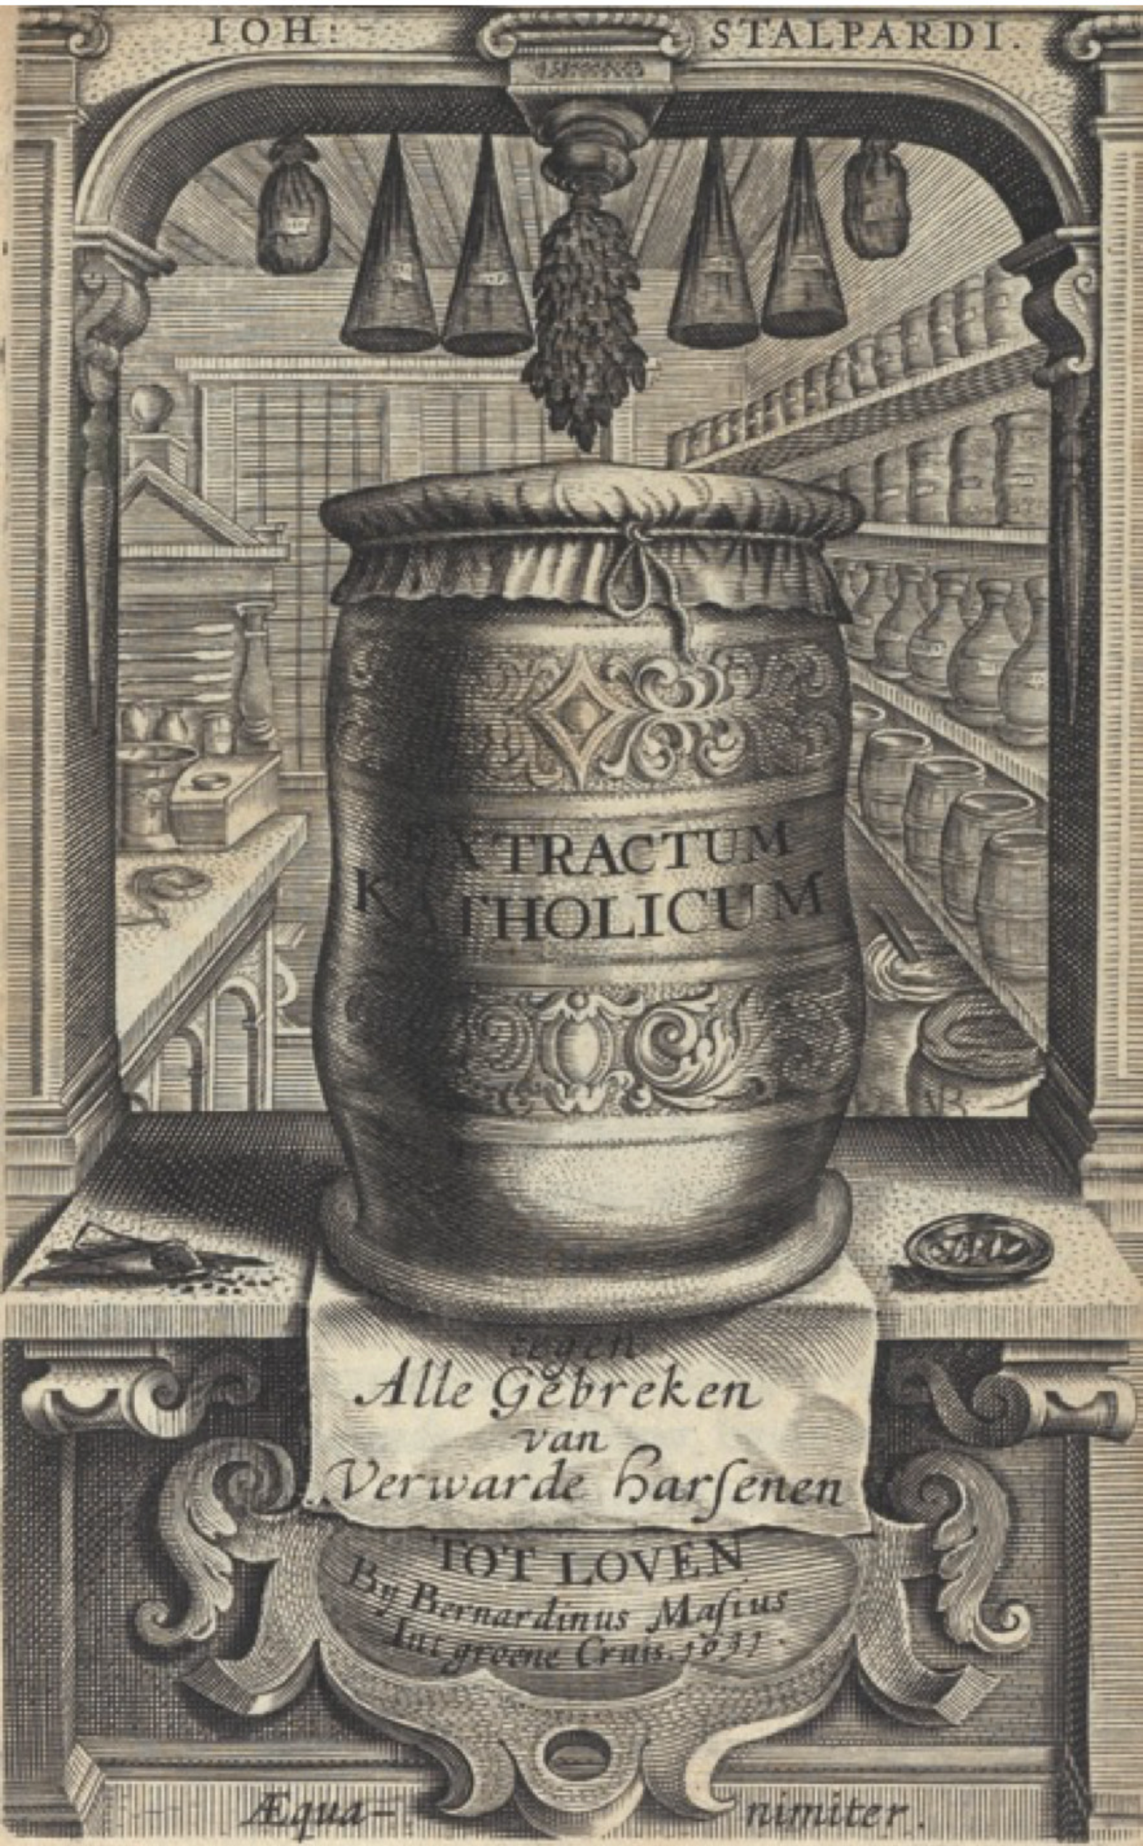

offline
Digital
research
exhibition
customer
innovation
connecting offline & online products

Slide 15
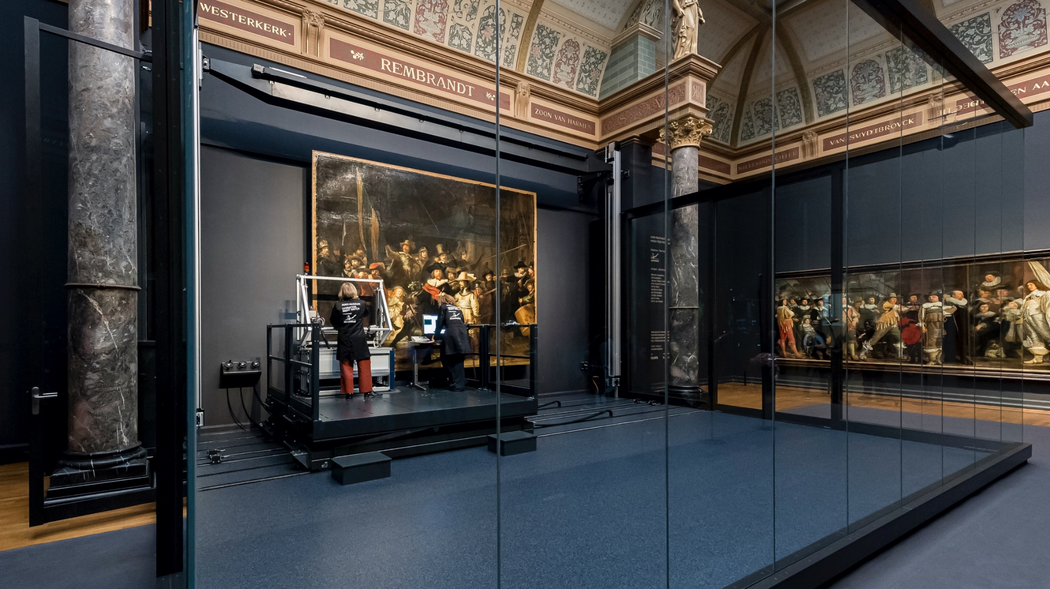
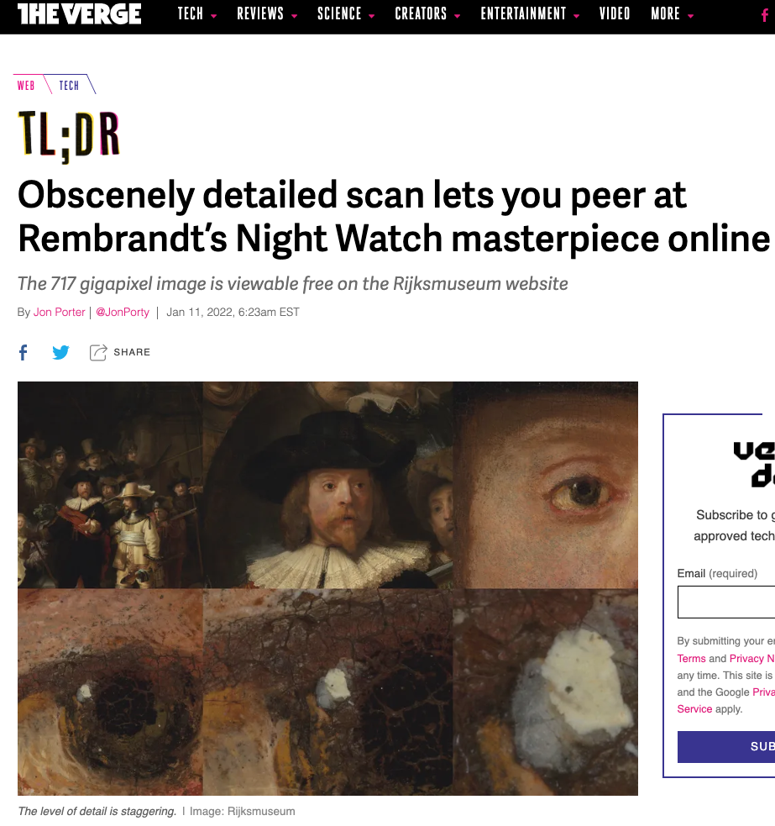
DATA DRIVEN RESEARCH AND RESTORATION
500 TB of research data
717 gigapixels
Total file size 5.6 terabytes
AI was used to stitch 8439 individual photos together
https://www.rijksmuseum.nl/en/whats-on/exhibitions/operation-night-watch/story/results-of-the-research
Operation Nightwatch

Slide 16
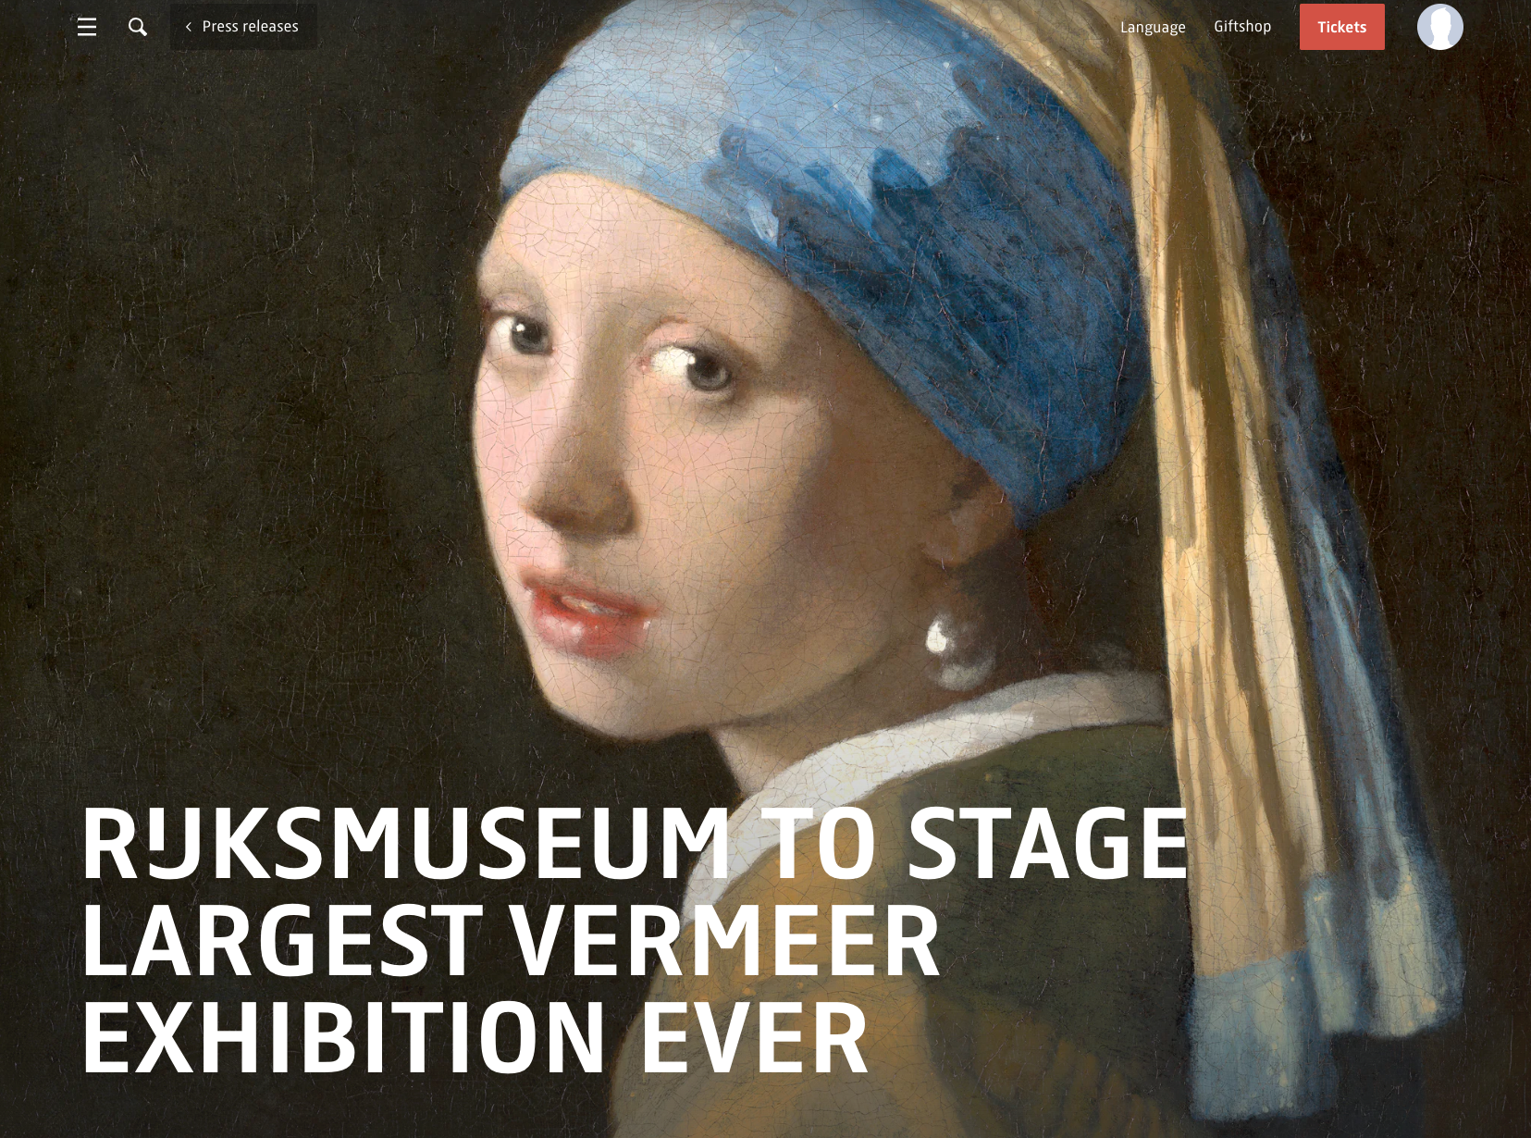
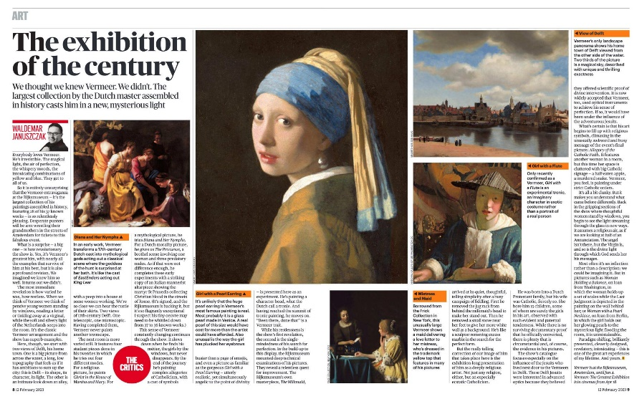
Notes:
sold out in just days

Slide 17
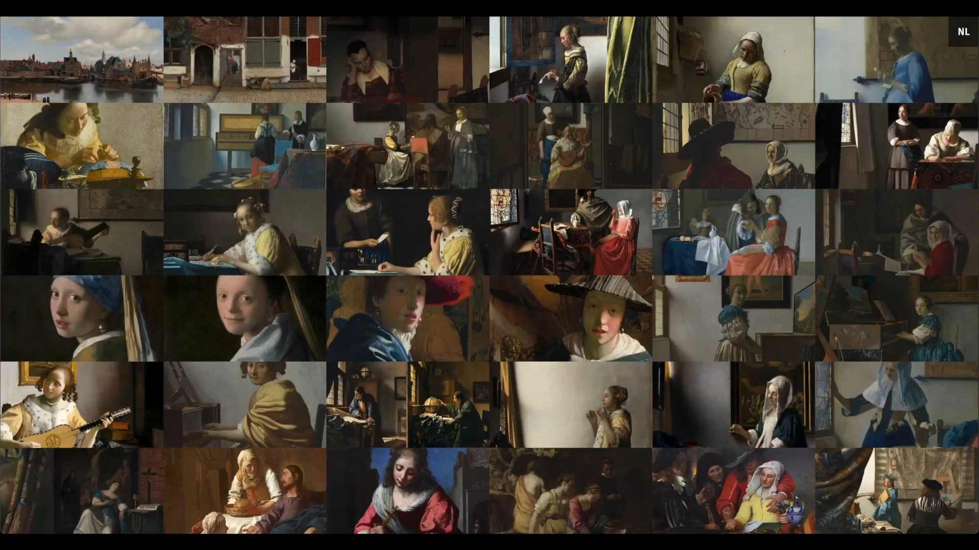

Slide 18
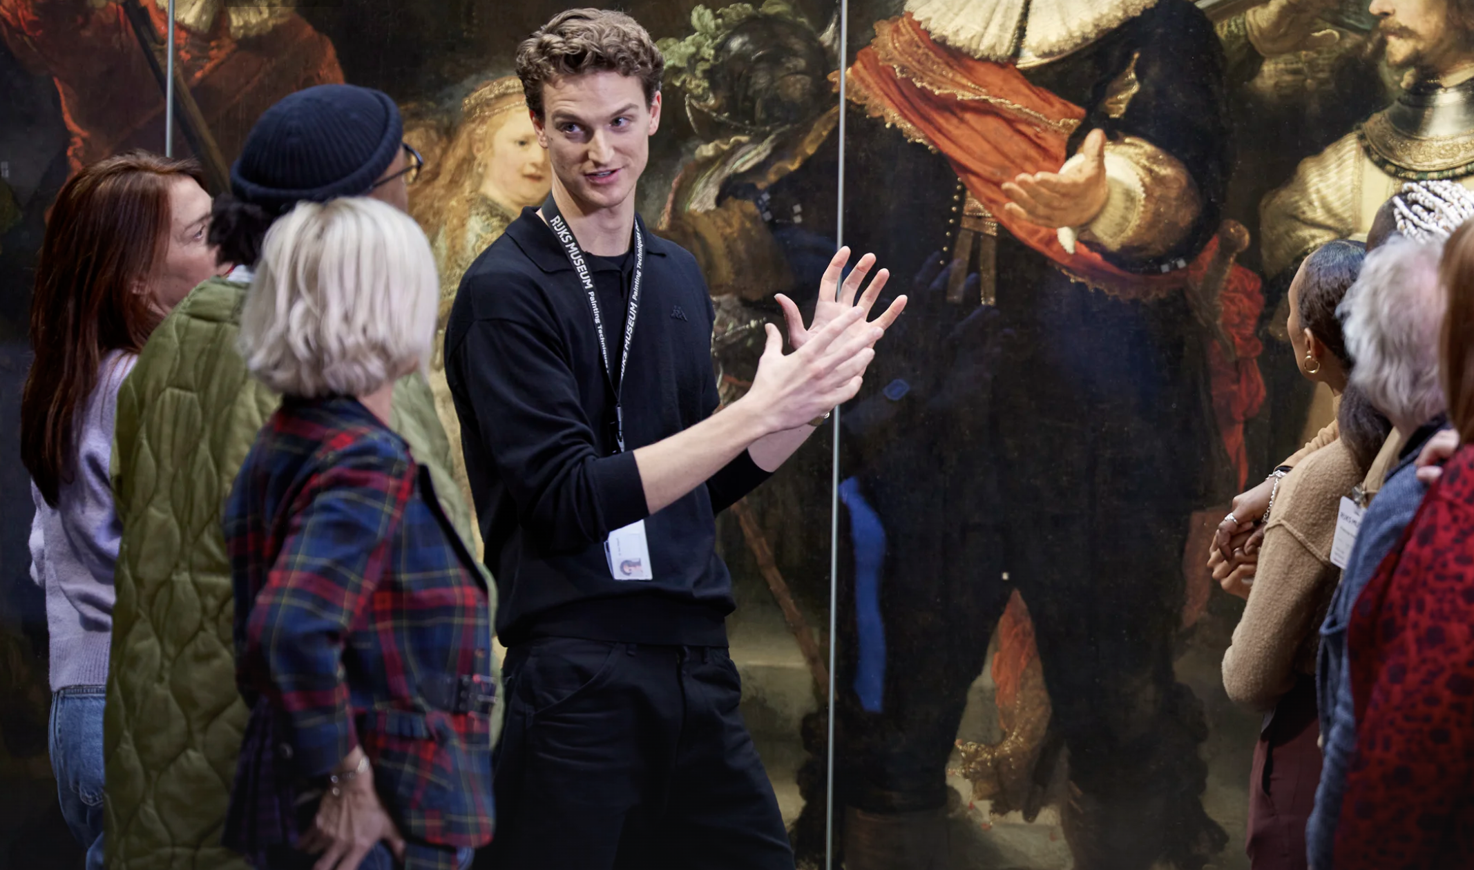
fine art, beautiful customer journey
customer journey offline – one online platform

Slide 19
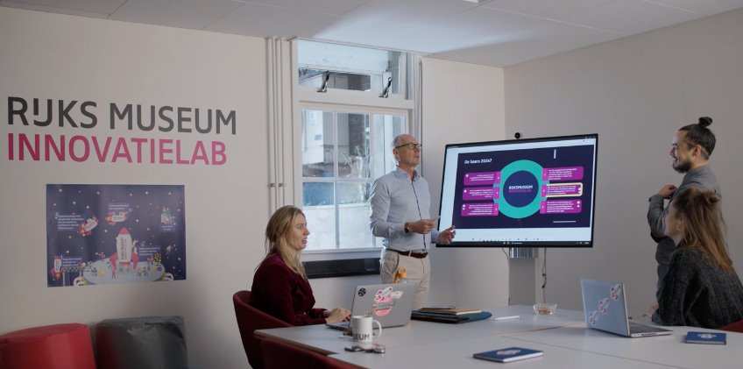

Slide 20
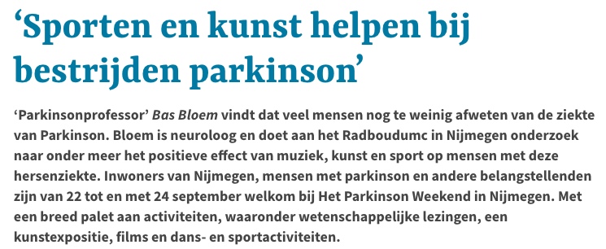
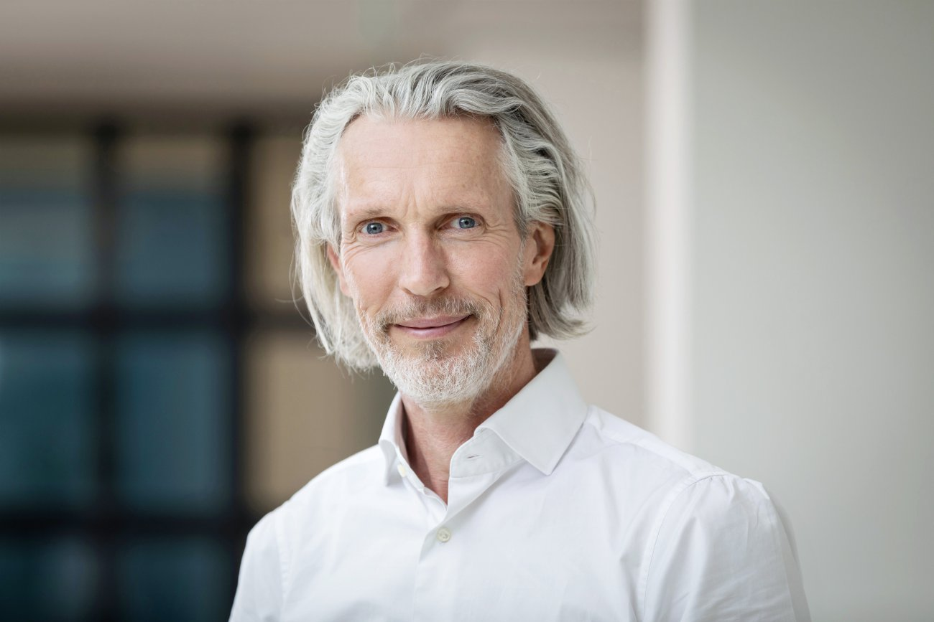
‘Sports and Art Help Combat Parkinson’s’
'Parkinson Professor' Bas Bloem believes that many people still know too little about Parkinson's disease. Bloem is a neurologist and conducts research at Radboudumc in Nijmegen on, among other things, the positive effects of music, art, and sports on people with this brain disease. Residents of Nijmegen, people with Parkinson's, and other interested parties are welcome at The Parkinson Weekend in Nijmegen from September 22 to 24. The event features a wide range of activities, including scientific lectures, an art exhibition, films, and dance and sports activities.

Slide 21
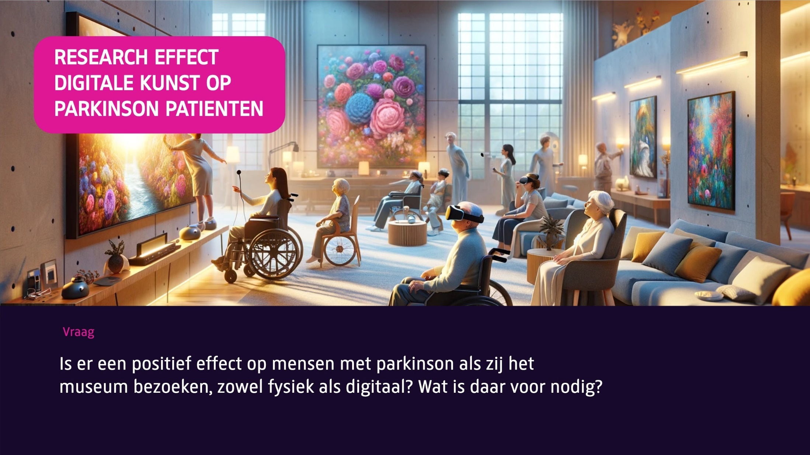
RESEARCH EFFECT OF
DIGITAL ART ON
PARKINSON’S PATIENTS
Question
Is there a positive effect on people with Parkinson's when they visit the museum, both physically and digitally? What is needed for that?
Notes:
In addition to contributing to improving the lives of Parkinson's patients, it can also mean a new business model for the museum, for example in collaboration with health insurers

Slide 22
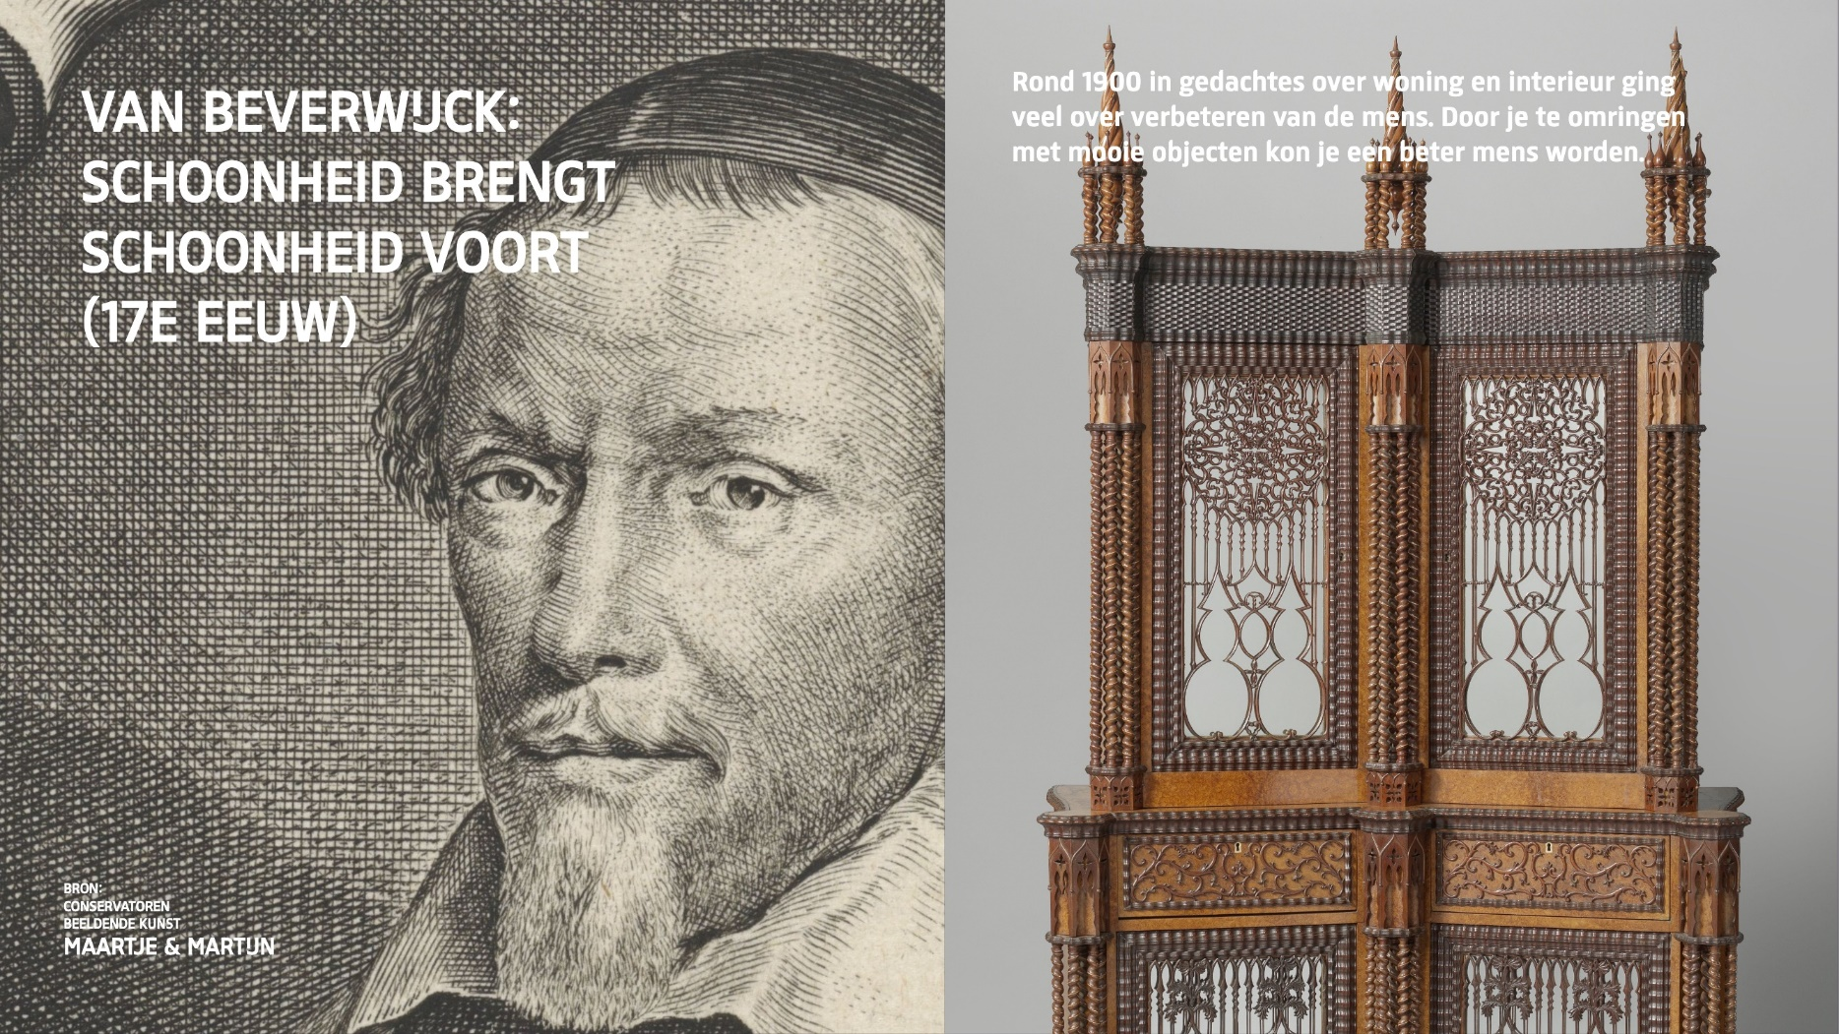
The relationship between health and art has existed for centuries
Notes:
Van Beverwijk published on the health aspects of art and beauty as early as the 17th ^{century}

Slide 23
The Art of Enterprise Architecture
r.steman@rijksmuseum.nl
r.hendriks@rijksmuseum.nl

